Slide 1
Museums Acquisitions
2019
Prepared by Amanda T. Zehnder, Ph.D.
Chief Curator, Museums
azehnder@udel.edu

Slide 2
Purchases

Slide 3
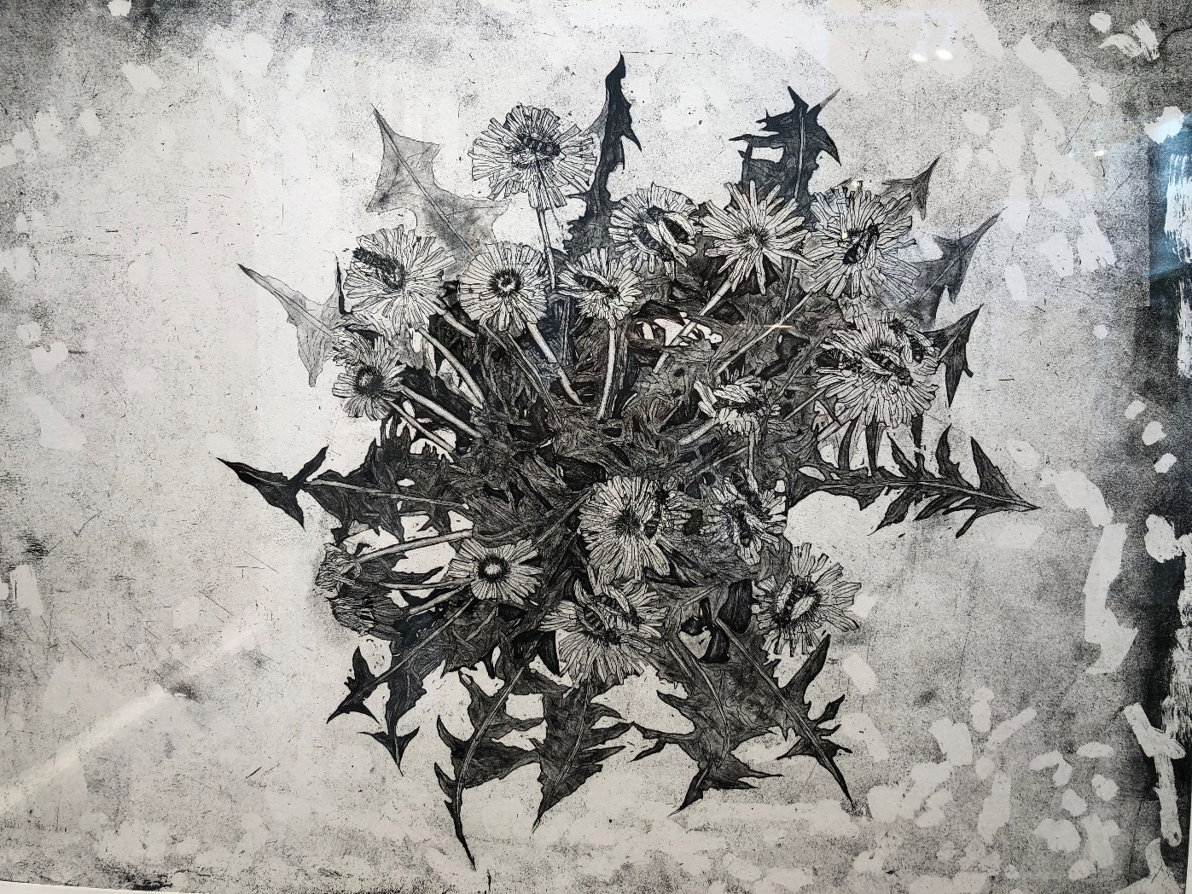
Kiki Smith Healers, 2018 etching on paper edition, 6/24

Slide 4
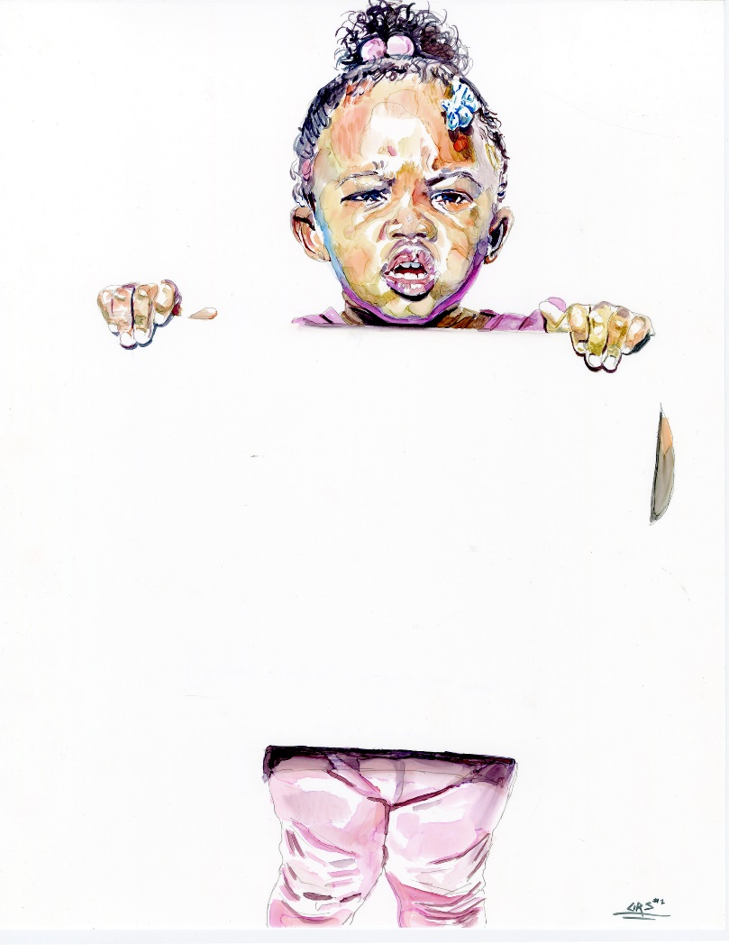
Darius Steward Read the Signs (Yummie Series), 2019 ink on Yupo paper

Slide 5
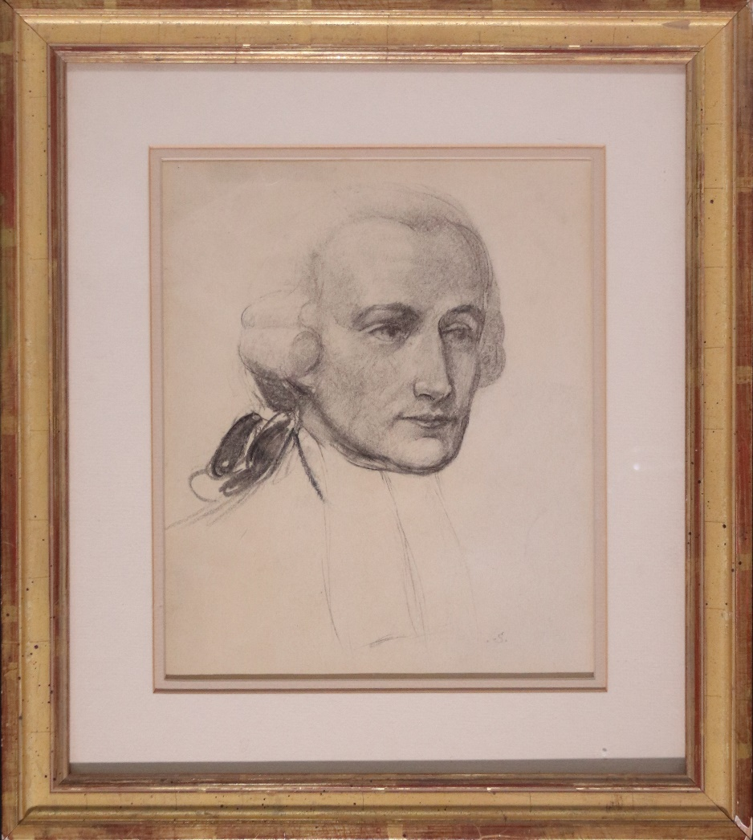
Frank Schoonover Francis Alison, Portrait, 20th century graphite, charcoal and wash on paper

Slide 6
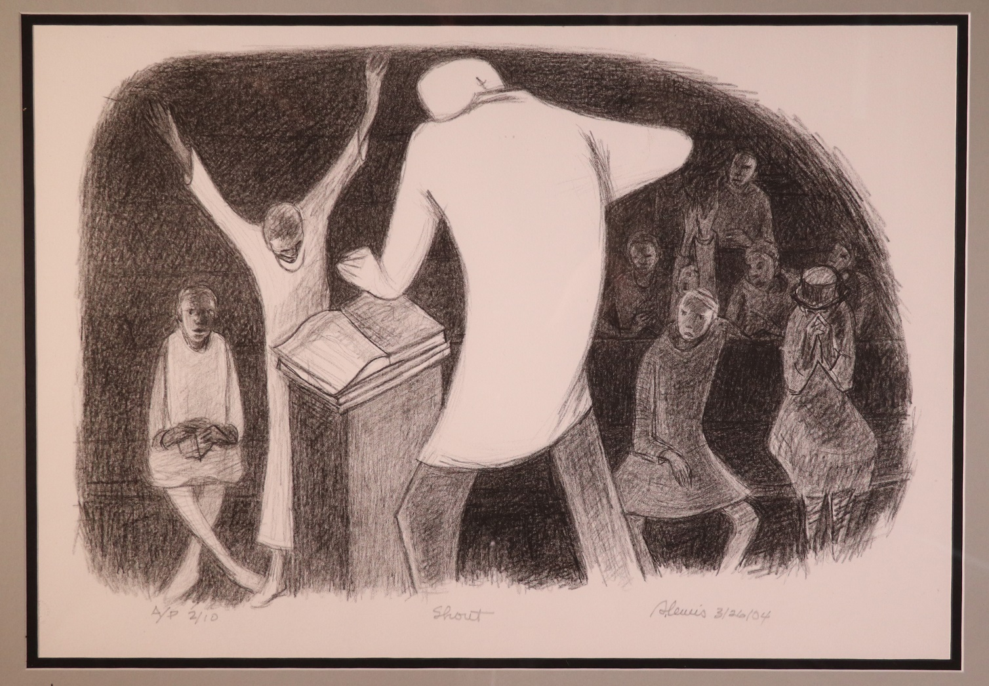
Samella Lewis Shout, 2004 lithograph on paper A/P edition of 60

Slide 7
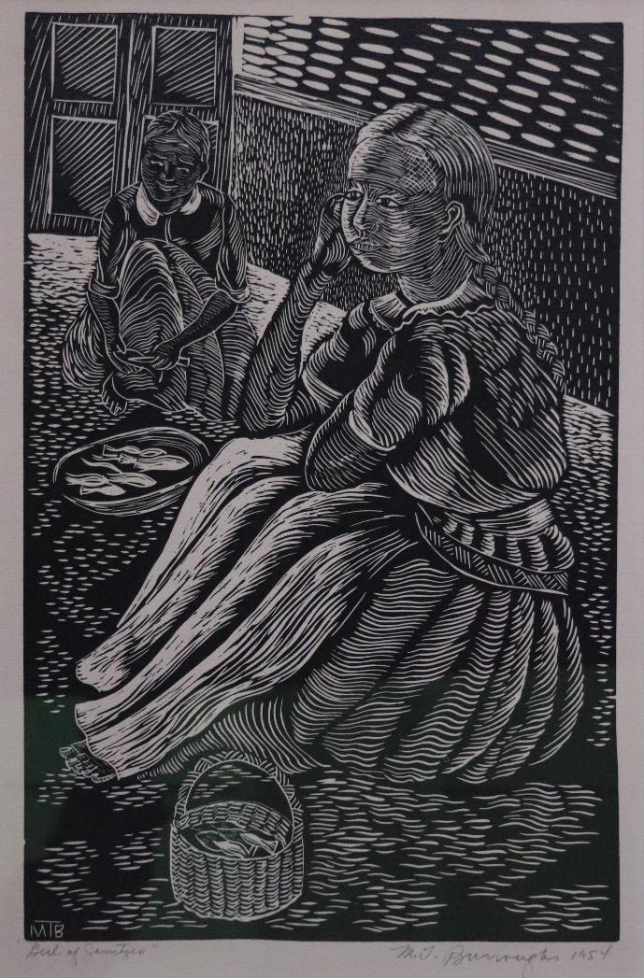
Margaret Burroughs Girls of Janitzio, 1954 linocut on paper

Slide 8
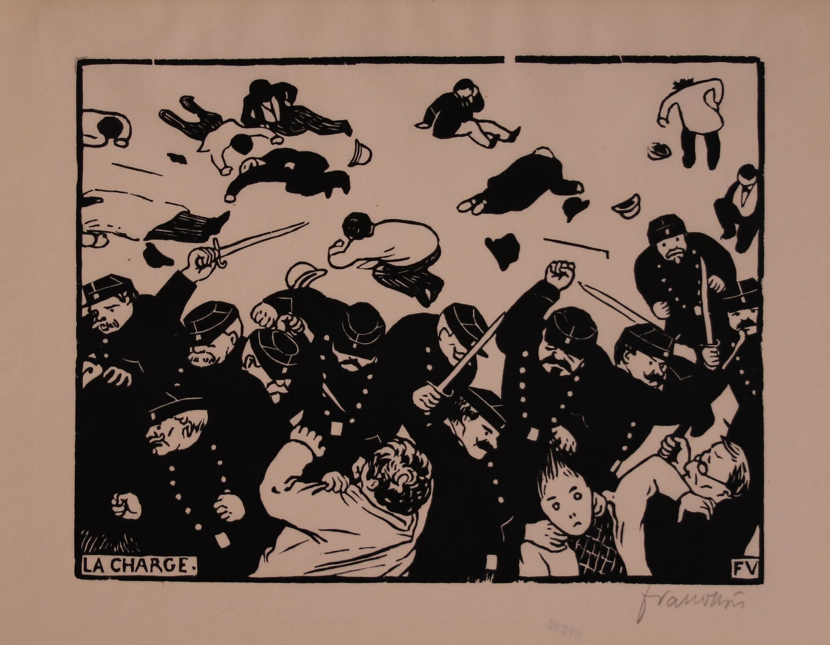
Félix Vallotton La Charge (The Charge), 1893 woodcut on paper

Slide 9
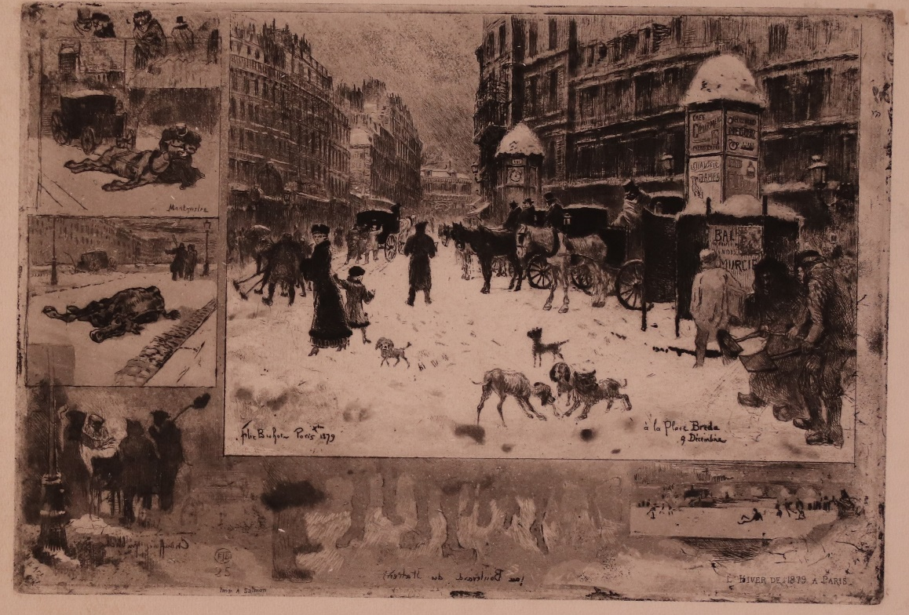
Félix Buhot L’Hiver à Paris, or La Neige à Paris (Winter in Paris, or Snow in Paris), 1879 etching and aquatint

Slide 10
Gifts

Slide 11
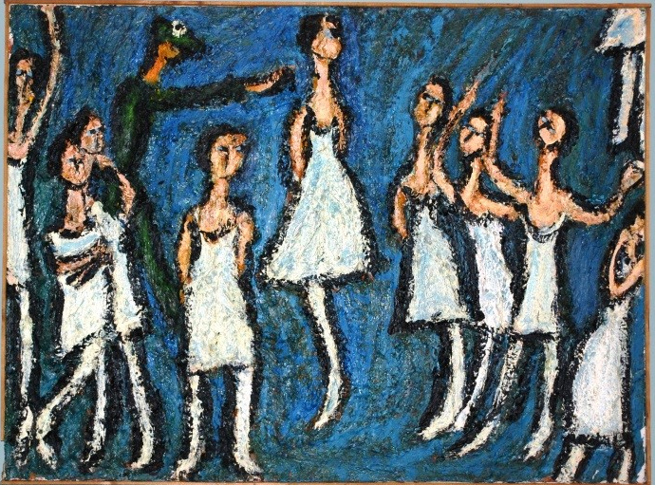
Tokujiro Nishi Tokyo Ballet, 1965 oil on canvas

Slide 12
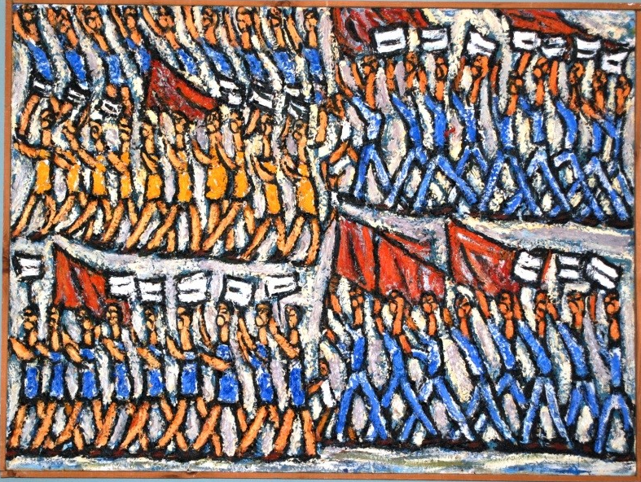
Tokujiro Nishi Demonstration for Peace in Tokyo, 1974 oil on canvas

Slide 13
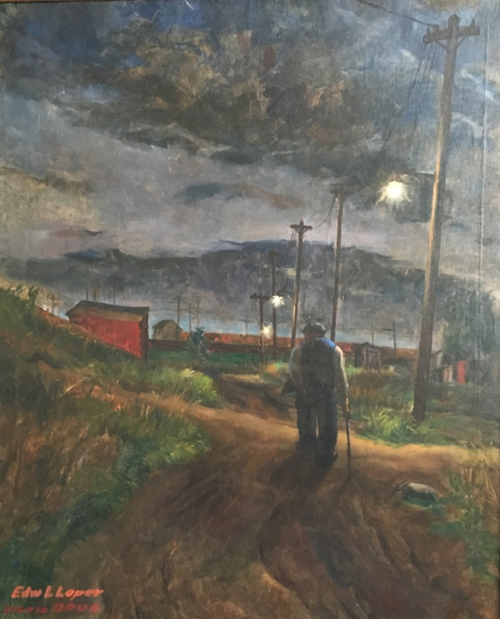
Edward Loper, Sr. Figure in a Landscape, c. 1940s/ signed 2006 oil on canvas

Slide 14
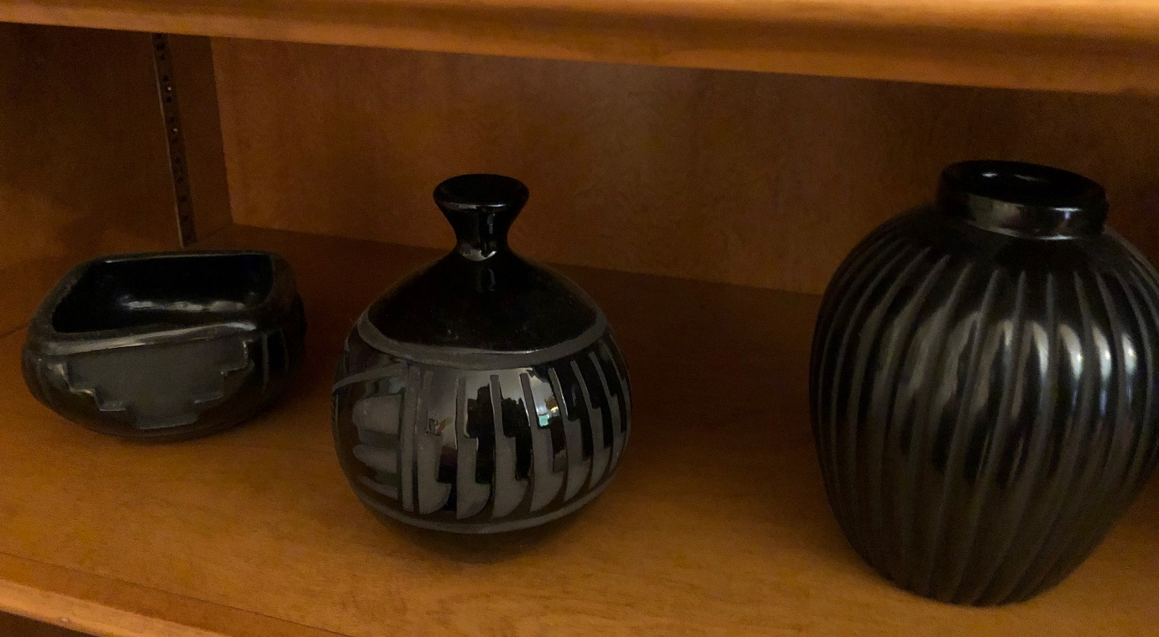
Santa Clara blackware vessels – 3 examples of the 18 Inuit and Native American carvings, pots, and baskets donated by Leslie and Virginia Tronzo in 2019. Another group of objects will be accessioned in 2020.

Slide 15
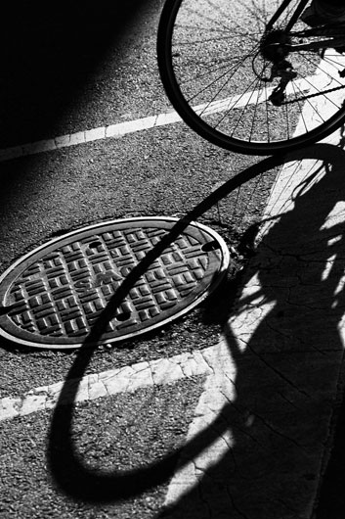
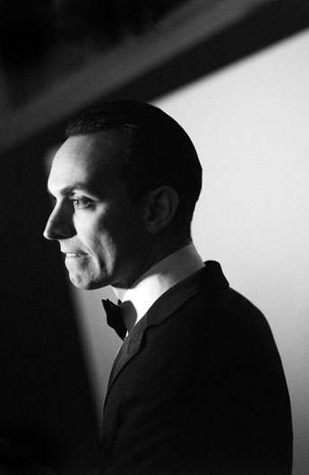
Ralph Gibson two examples from his complete series of 105 photographs, MONO, 2013 archival pigment prints (each photograph signed, dated and editioned on recto)
Plate 83
Plate 102

Slide 16
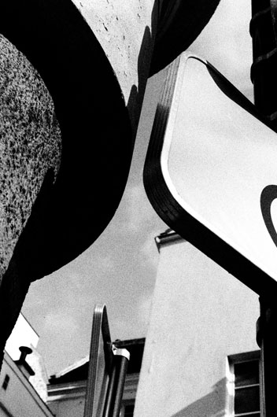
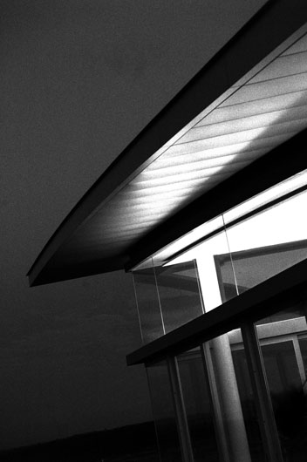
Ralph Gibson two examples from his complete series of 105 photographs, MONO, 2013 archival pigment prints (each photograph signed, dated and editioned on recto)
Plate 20
Plate 2

