Slide 1
Museums Acquisitions 2020 with select images compiled by Amanda Zehnder, Ph.D. Chief Curator, Museums

Slide 2
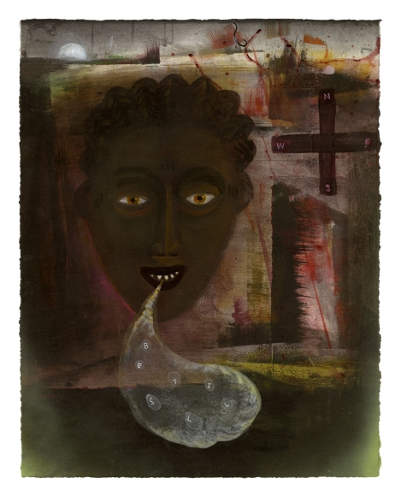
Renée Stout What the Oracle Said, 2020 Edition of 18- A/P archival pigment print 14" x 11" on paper 19" x 13"
“It boggles my mind that during the worst pandemic this generation has ever seen, that people are having a hard time sheltering and taking this time to process and reassess their priorities, because our society has been moving at a pace that doesn’t leave much room for reflection and introspection. We live in a culture where we have been trained to constantly live outwardly and to want whatever we want, whenever we want it and fast. Time in quarantine has allowed me to ponder things spiritually and philosophically and I’ve come to the conclusion that the universe may be trying to send the world the message that it’s time for everyone to take some time to slow down and be still.“
- Renée Stout, August 2020

Slide 3
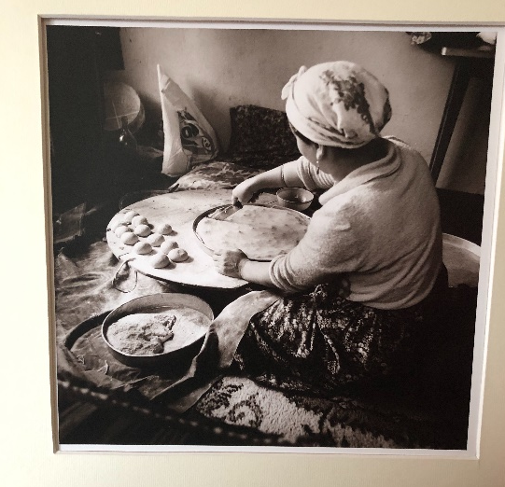
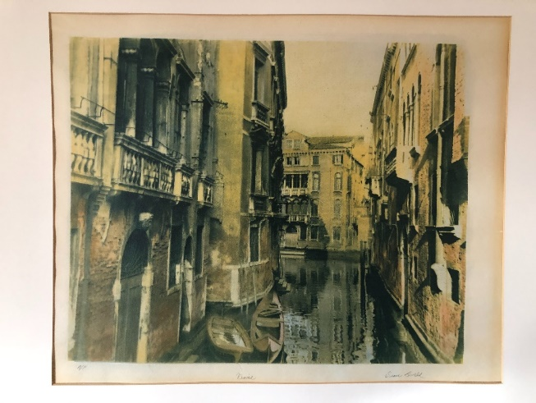
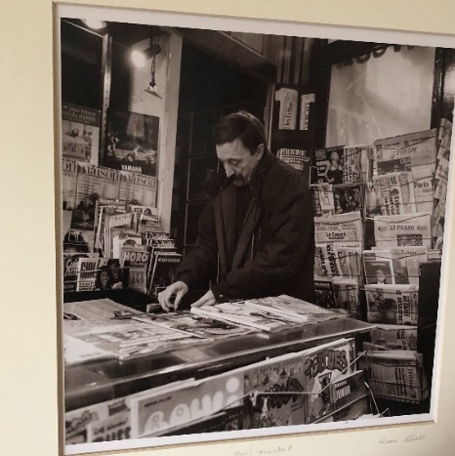
Diane Levell, 6 photographs
Fatima’s Daughter Making Borek, Turkey,
shot 1981/ printed 1986
Gelatin silver print
Venice, 1989
Cyanotype and Gum bichromate, A/P
Paris Newstand, c. 1985
Gelatin silver print, A/P

Slide 4
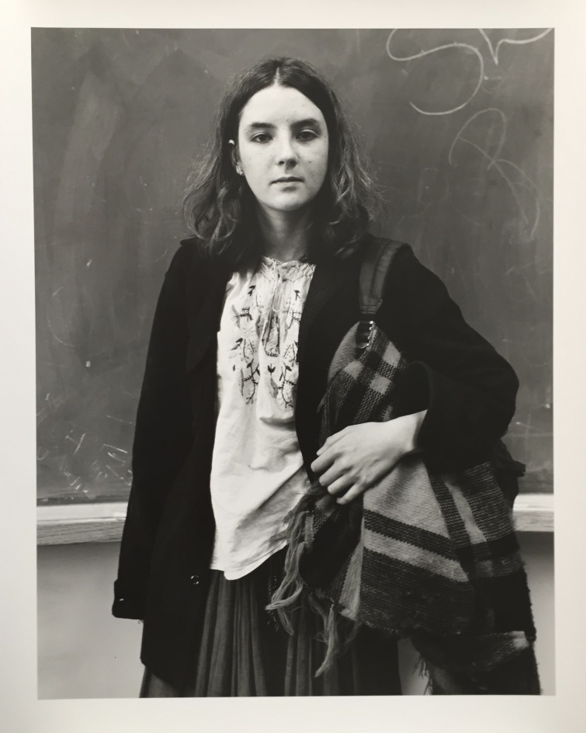
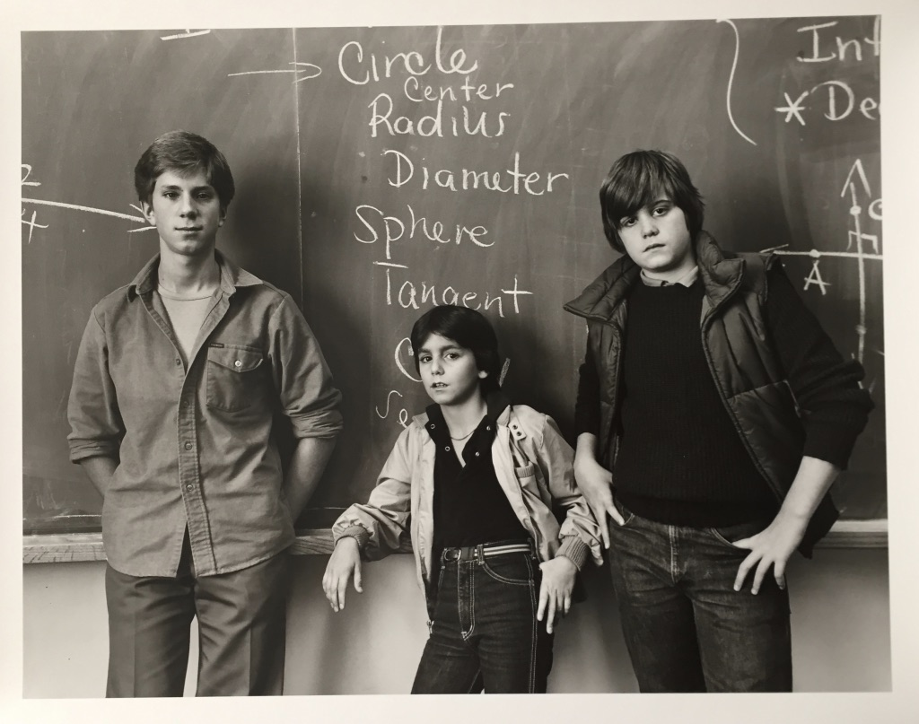
Linda Benedict-Jones, 31 photographs
16” x 20” gelatin silver prints from the portrait series CRLS (Cambridge Rindge & Latin School)
Circle Center Radius, 1981
Girl with Peasant Blouse and Blanket, 1981

Slide 5
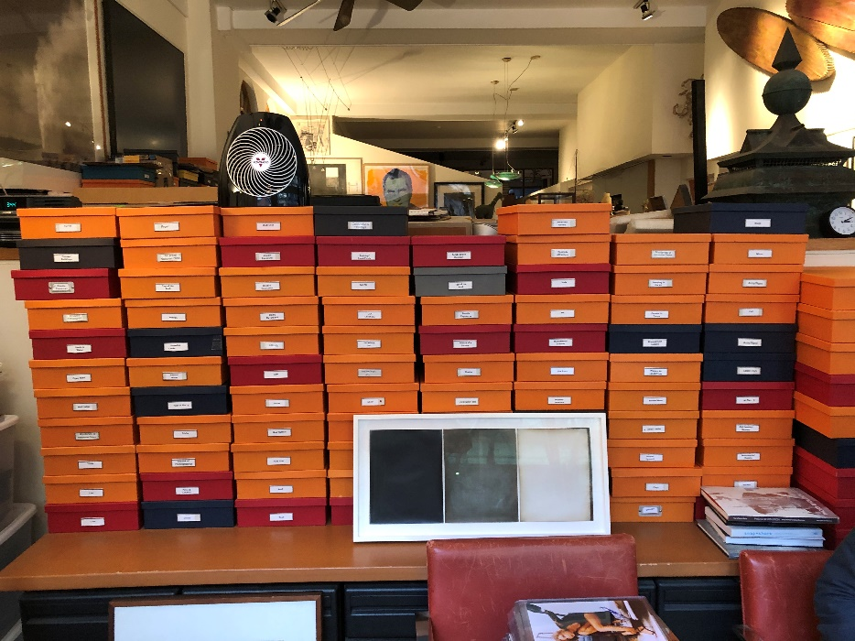
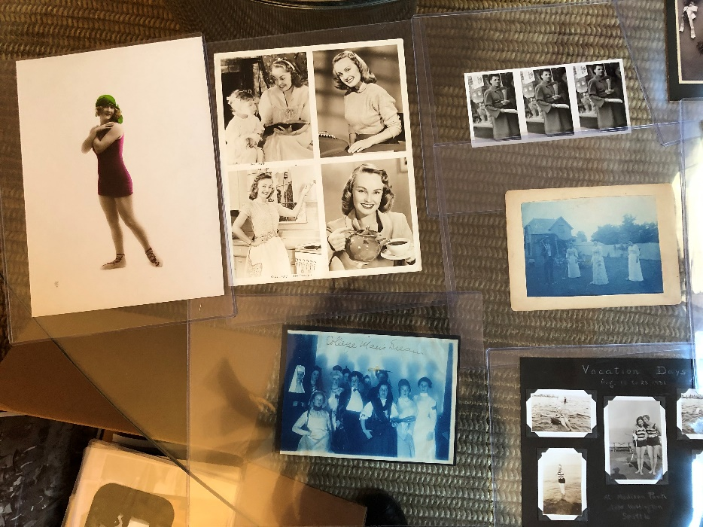
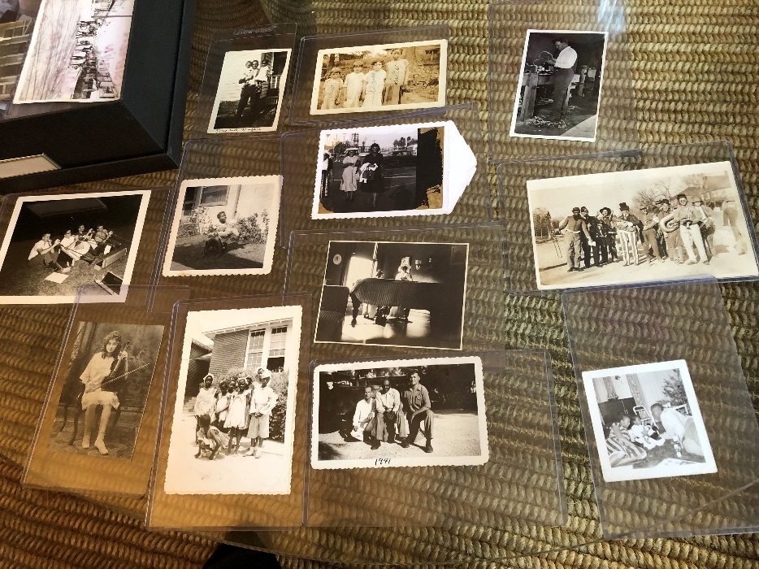
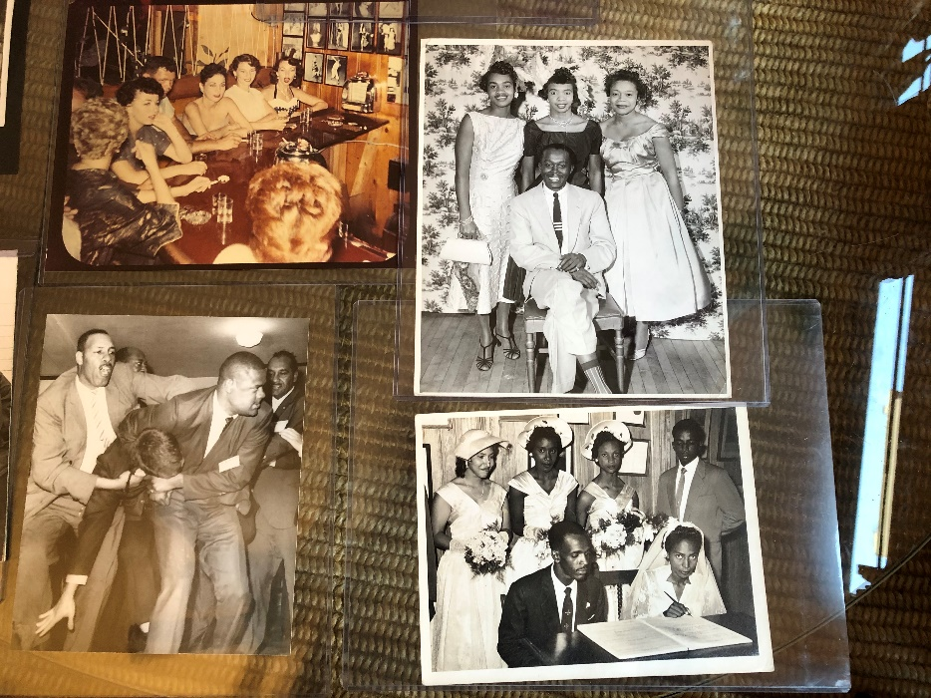
Peter J. Cohen Collection https://www.pjcohencollection.com/
Snapshots from January 2020 visit to
the collection in New York City.

Slide 6
Inventory of Peter Cohen Gift
Albums: 1
Compilations/Publications: 5
Individual photographs: 128
Breakdown of types of individual photographs:
Photographs in 4”x6" sleeves:
Black and white: 72
Hand tinted: 5
Color: 3
Photographs in 8”x10" sleeves: Black and white: 25 Hand tinted: 8 Cyanotypes: 2 Color: 2 Photographs in 3”x4" sleeves: 11, all black and white

Slide 7
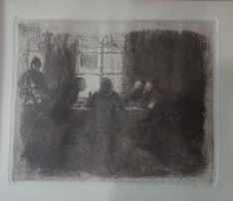
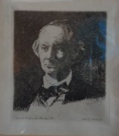
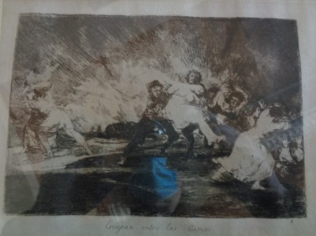
13 works of art: prints, maps, watercolor, and painting on copper
Käthe Kollwitz
Vier Männer in der Kneipe (Four Men in a Tavern), 1892-1893
etching on paper
Edouard Manet
Baudelaire, 1868
etching on paper
Francisco Goya, Escapan entre las Llamas (They Escape Through the Flames), c.1810, from Los Desastres de la Guerra, etching and burin on paper

Slide 8
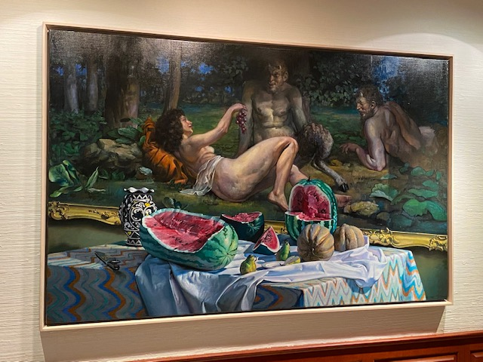
Stephen Tanis
Baccante, 1987
oil on linen
45 ½” x 72”

Slide 9
Larry Fink, 46 photographs
Ed Rendell’s Inauguration, Harrisburg Pennsylvania, January, 2003
Signed, Dated and Titled on verso
20" x 16" Gelatin Silver Print
Torricelli/Zimmer Campaign, New Jersey, October, 1996
Signed, Dated, and Title on verso
20" x 16" Gelatin Silver Print

Slide 10
Larry Fink
New Hampshire Primary, February, 1996
Signed, Dated, and Title on Verso in Pencil
20" x 16" Gelatin Silver Print

Slide 11
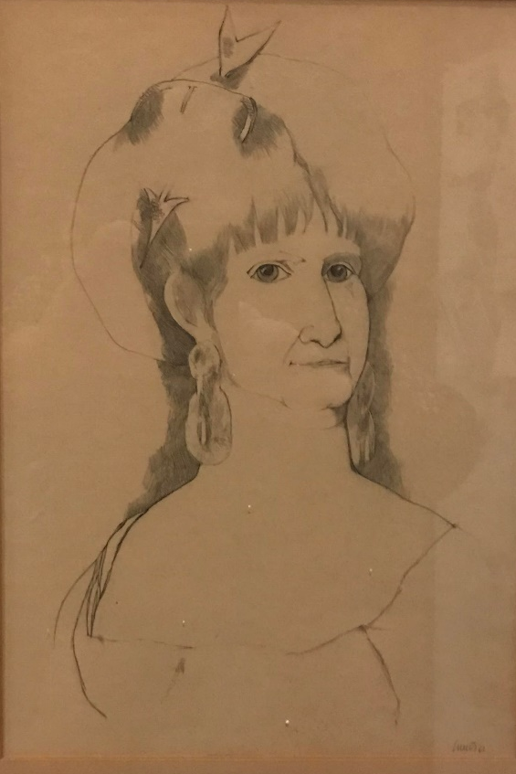
Julio daCunha
[Drawing of a Woman], n.d.

