Slide 1
Museums Acquisitions
First Half of 2021

Slide 2
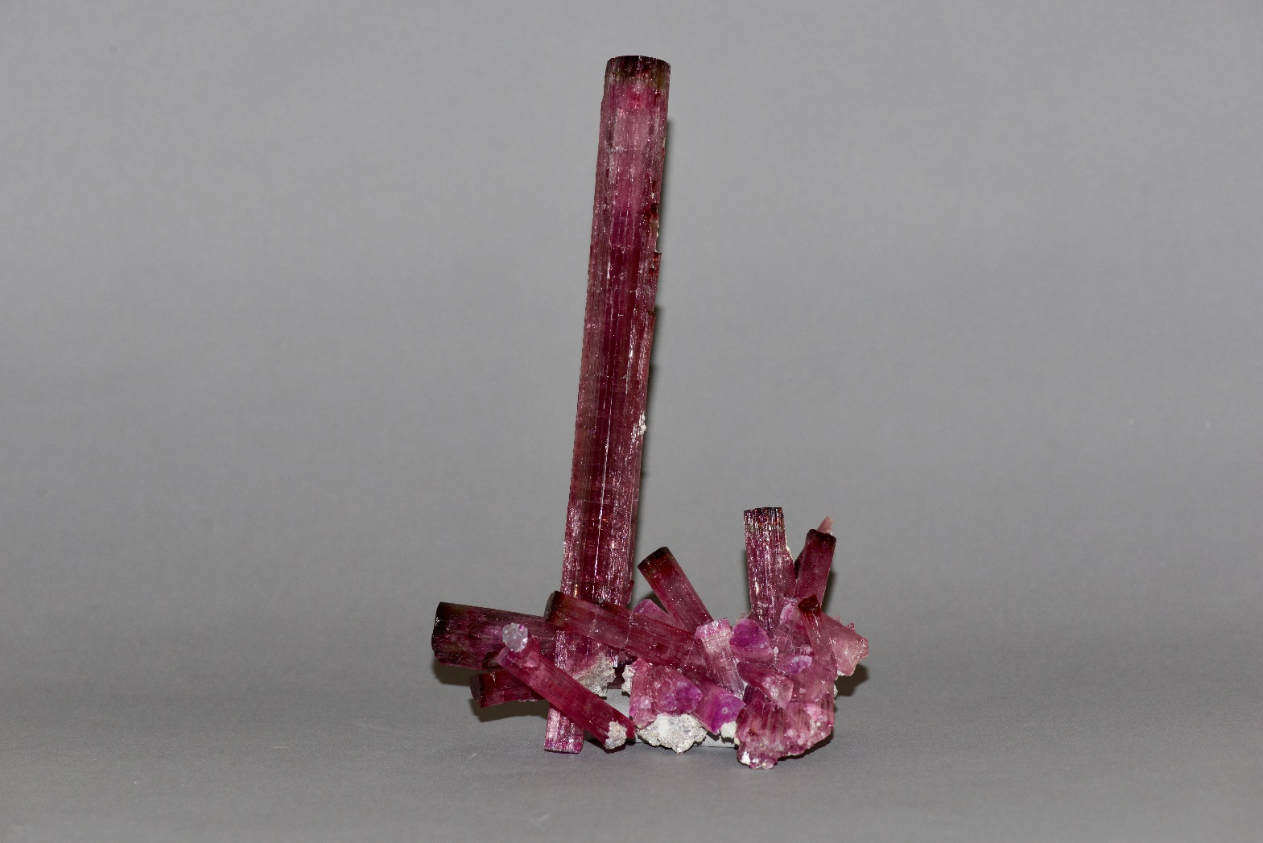
Elbaite (Tourmaline group), Cruzeiro mine, Minas Gerais, Brazil, 8 1/2 inches.

Slide 3
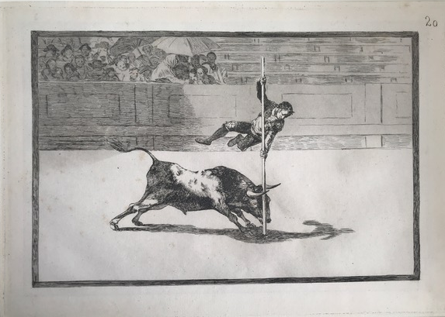
Goya (Francisco de Goya y Lucientes), (Spanish, 1746–1828)
The Agility and Audacity of Juanito Apiñani in the Ring at Madrid, 1816 etching and aquatint on paper
Plate 20 from the 'Tauromaquia'
Etching, aquatint, 1816
Plate mark: 9 5/8 × 13 7/8 in. (24.5 × 35.3 cm)
Acquired in honor of Janis Tomlinson’s
retirement.

Slide 4
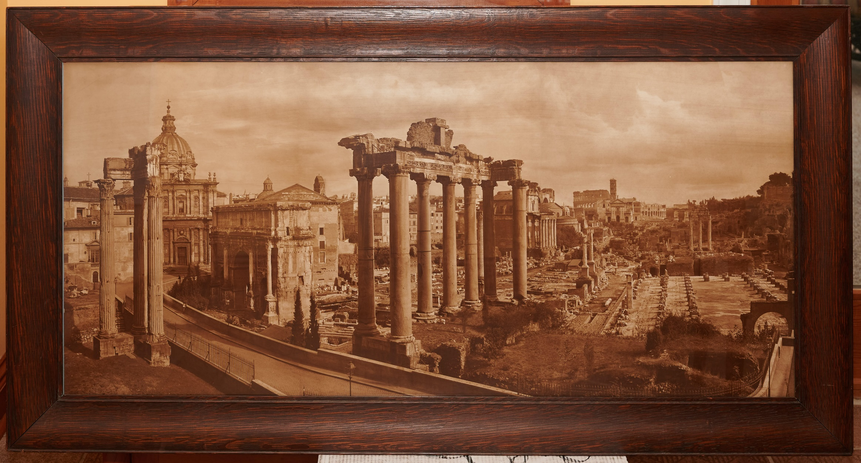
Attributed to Adolphe Braun and Co., [Roman Forum Panorama], c. 1890, carbon print photograph. In its original frame. 57 x 30 inches, including the frame.
Gift of Ralph Nigro

